Slide 1
Class Diagram

Slide 2
Introduction
The class diagram is a static diagram.
It represents the static view of an application.
Class diagram is not only used for visualizing, describing and documenting different aspects of a system but also for constructing executable code of the software application.
The class diagram describes the attributes and operations of a class and also the constraints imposed on the system.

Slide 3
Contd...
The class diagrams are widely used in the modelling of object oriented systems because they are the only UML diagrams which can be mapped directly with object oriented languages.
The class diagram shows a collection of classes, interfaces, associations, collaborations and constraints
.
It is also known as a structural diagram.

Slide 4
Purpose
Analysis and design of the static view of an application.
Describe responsibilities of a system.
Base for component and deployment diagrams.
Forward and reverse engineering.

Slide 5
How to draw Class Diagram?
Class diagrams are the most popular UML diagrams used for construction of software applications.
Class diagrams have lot of properties to consider while drawing but here the diagram will be considered from a top level view.
Class diagram is basically a graphical representation of the static view of the system and represents different aspects of the application.
So a collection of class diagrams represent the whole system.

Slide 6
Contd…
The name of the class diagram should be meaningful to describe the aspect of the system.
Each element and their relationships should be identified in advance.
Responsibility (attributes and methods) of each class should be clearly identified.
For each class minimum number of properties should be specified. Because unnecessary properties will make the diagram complicated.

Slide 7

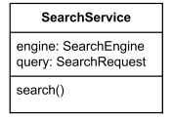
Notation
A class is shown as a solid-outline rectangle containing the class name.
When class is shown with three compartments, the middle compartment holds a list of attributes and the bottom compartment holds a list of operations.

Slide 8
A class is a description of a set of objects that share the same attributes, operations, relationships, and semantics.
Graphically, a class is rendered as a rectangle, usually including its name, attributes, and operations in separate,
designated compartments.
ClassName
attributes
operations

Slide 9
Class Names
ClassName
The name of the class is the only required tag in the graphical representation of a class. It always appears in the top-most compartment.
attributes
operations

Slide 10
Class Attributes (Cont’d)
Attributes are usually listed in the form:
attributeName : Type
A derived attribute is one that can be
computed from other attributes, but
doesn’t actually exist.
For example,
a Person’s age can be computed from
his birth date. A derived attribute is
designated by a preceding ‘/’ as in:
/ age : Date
Person
name : String
address : Address
birthdate : Date
/ age : Date
ssn : Id

Slide 11
Class Attributes (Cont’d)
Person
Attributes can be: (Adornments)
+ public
# protected
- private
/ derived
+ name : String
# address : Address
# birthdate : Date
/ age : Date
- ssn : Id

Slide 12
Class Operations
Person
Operations describe the class behavior
and appear in the third compartment.
name : String
address : Address
birthdate : Date
ssn : Id
eat
sleep
work
play

Slide 13
Class Operations (Cont’d)
PhoneBook
newEntry (n : Name, a : Address, p : PhoneNumber, d : Description)
getPhone ( n : Name, a : Address) : PhoneNumber
You can specify an operation by stating its signature: listing the name, type, and default value of all parameters, and, in the case of functions, a return type.

Slide 14
Relationships
In UML, object interconnections (logical or physical), are
modeled as relationships.
There are three kinds of relationships in UML:
dependencies
generalizations
associations

Slide 15
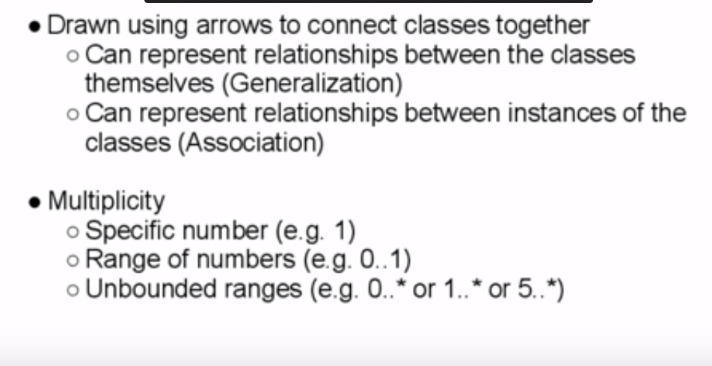
Relationship between classes

Slide 16
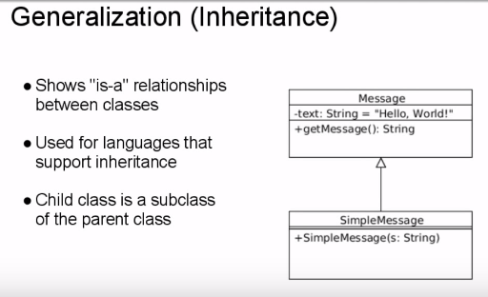

Slide 17
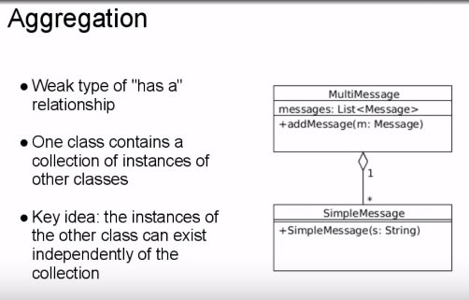

Slide 18
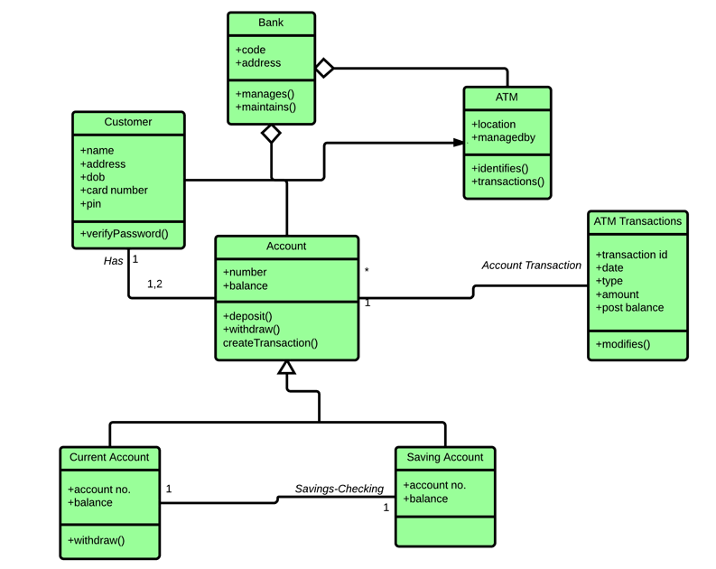

Slide 19
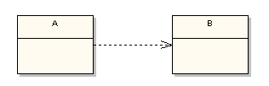

Class Relationships

Slide 20
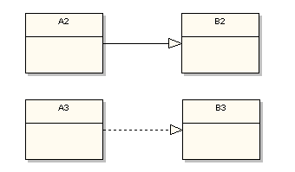

Slide 21
Dependency
The UML dependency relationship is the least formal of them all.
It means that the class at the source end of the relationship has some sort of dependency on the class at the target (arrowhead) end of the relationship.
For example, the following simple states that class A depends on class B in some way

Slide 22
Association
The arrowhead means that there is a one-way relationship.
In this example it means that class A1 is associated with class B1.
In other words, class A1 uses and contains one instance of class B1, but B1 does not know about or contain any instances of class A1.

Slide 23
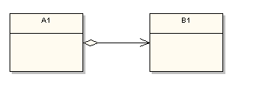
Aggregation Association
A clear diamond adornment has been added to the source side of the relationship.
This means that A1 aggregates a B1. Aggregation describes an association where an instance of A1 contains a reference to an instance of B1

Slide 24
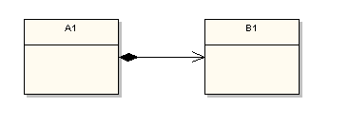
Composition
The composition adornment looks like the aggregation adornment, except the composition adornment is darkened:

Slide 25
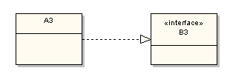
Realization
This relationship is somewhat related to generalization, but a bit different. In object-oriented programming parlance realization represents the implementation of an interface by a class.

Slide 26
